Slide 1
Southern Boone County R-1 School District
2016 Bond Issue Campaign
4 classroom addition to Elementary School
8 classroom and gym addition to Primary School
Weight room addition to High School

Slide 2
Elementary School Addition - 3D Model Image
Southern Boone County R-1 School District

Slide 3
Elementary School Addition - 3D Model Image
Southern Boone County R-1 School District

Slide 4
Elementary School Addition - 3D Model Image
Southern Boone County R-1 School District

Slide 5
Elementary School Addition - 3D Model Image
Southern Boone County R-1 School District

Slide 6
Elementary School Addition - Partial Floor Plan
Southern Boone County R-1 School District

Slide 7
Elementary School Addition
4,300 SF
Budget: $1.1 million
Schedule: Completed summer 2017
Southern Boone County R-1 School District

Slide 8
Primary School Addition - 3D Model Image
Southern Boone County R-1 School District

Slide 9
Primary School Addition - 3D Model Image
Southern Boone County R-1 School District

Slide 10
Primary School Addition - 3D Model Image
Southern Boone County R-1 School District

Slide 11
Primary School Addition - 3D Model Image
Southern Boone County R-1 School District

Slide 12
Primary School Addition - 3D Model Image
Southern Boone County R-1 School District

Slide 13
Primary School Addition - 3D Model Image
Southern Boone County R-1 School District

Slide 14
Primary School Addition - 3D Model Image
Southern Boone County R-1 School District

Slide 15
Primary School Addition - Partial Floor Plan
296 SEATS
50’ X 84’ BASKETBALL COURT
Southern Boone County R-1 School District

Slide 16
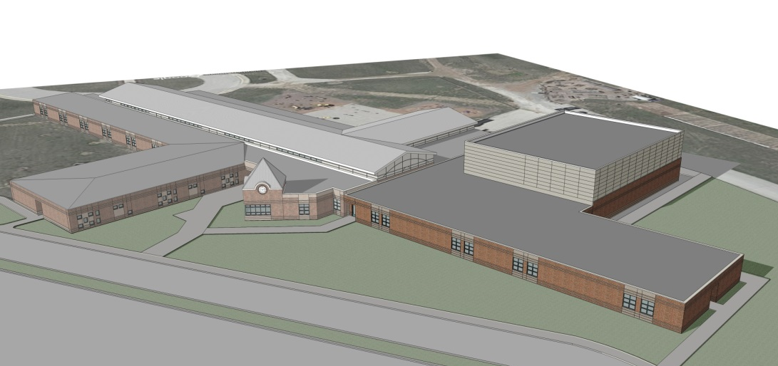
Primary School Addition
23,000 SF
Budget: $5.3 million
Schedule: Completed Fall 2017
Southern Boone County R-1 School District

Slide 17
High School Addition - 3D Model Image
Southern Boone County R-1 School District

Slide 18
High School Addition - 3D Model Image
Southern Boone County R-1 School District

Slide 19
High School Addition - Floor Plan
Southern Boone County R-1 School District

Slide 20
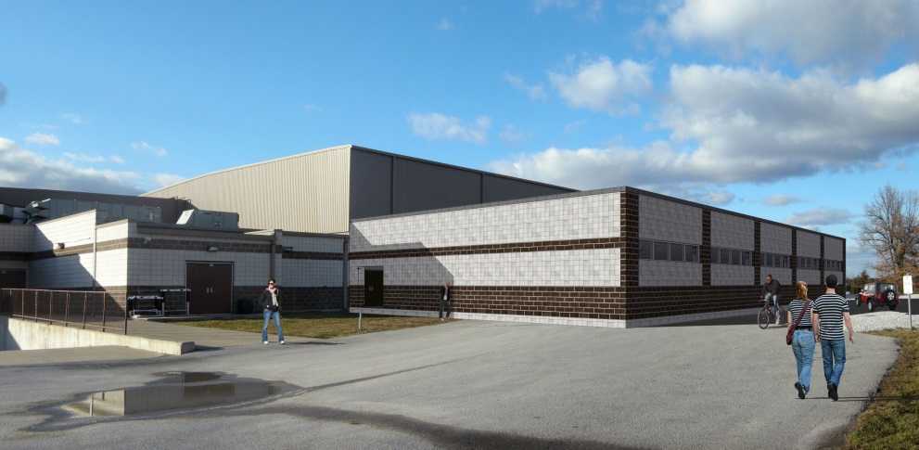
High School Addition
5,000 SF
Budget: $1.1 million
Schedule: Completed summer 2017
Total Project Budget without furniture: $7.5 million
Southern Boone County R-1 School District

